Slide 1
Introduction to React
Day 5
PPT-Master Version 01. There will be an extensive update with the new Deutsche Bank font and sample charts at the end of August 2024.
8 May 2024, Speaker name

Slide 2


What is React?
React is a JavaScript framework
Used for front end web development
Think of jQuery, but more structured
Created and used by Facebook
Famous for implementing a virtual dom

Slide 3




Timeline of front-end JavaScript frameworks
jQuery* (2006)
AngularJS (2010)
React (2013)
Vue (2014)
Angular (2014)
* jQuery is more often considered a library than a framework

Slide 4
Common tasks in front-end development
App state
Data definition, organization, and storage
User actions
Event handlers respond to user actions
Templates
Design and render HTML templates
Routing
Data fetching
Resolve URLs
Interact with server(s) through APIs and AJAX

Slide 5
Fundamentals of React
JavaScript and HTML in the same file (JSX)
Embrace functional programming
Components everywhere
8 May 2024, Speaker name

Slide 6



JavaScript and HTML in the same file
HTML
CSS
JS
JSX
CSS or JSS
Traditional Approach
React Approach

Slide 7
JSX: the React programming language
const first = "Aaron"; const last = "Smith";
const name = <span>{first} {last}</span>;
const listWithTitle = (
<>
<h1>COMP 523</h1>
<ul>
<li>Dr. David Stotts</li>
<li>{name}</li>
</ul>
</>
);
const list = (
<ul>
<li>Dr. David Stotts</li>
<li>{name}</li>
</ul>
);

Slide 8
“React is just JavaScript”
8 May 2024, Speaker name

Slide 9
Functional Programming
Functions are “first class citizens”
Variables are immutable
Functions have no side effects

Slide 10
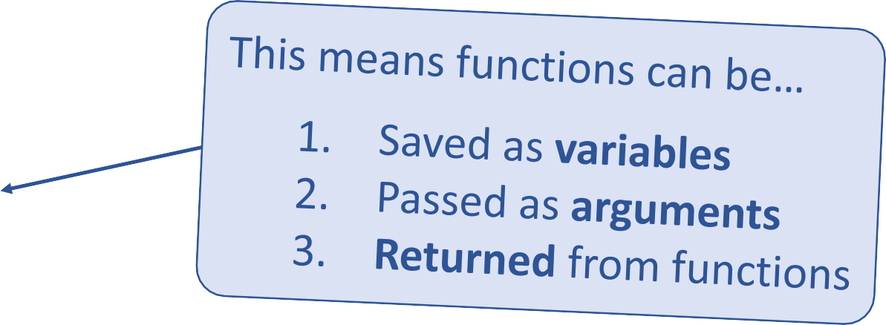
Functional Programming
Functions are “first class citizens”
let add = function() { console.log('Now adding numbers'); const five = 3 + 2;
};
function foo() { return function() {
console.log('What gets printed?');
};
}
foo foo(); foo()();
function performTask(task) { task();
console.log('Task performed!');
}
performTask(add);

Slide 11
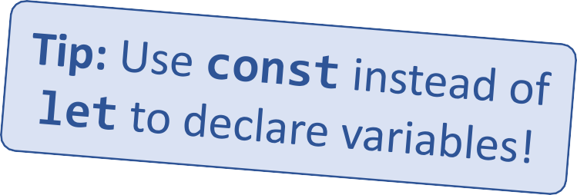
Functional Programming
Variables are immutable.
let a = 4;
a = 2; // Mutates `a`
let b = [1, 2, 3];
b.push(4); // Mutates `b`
let c = [...b, 4]; // Does not mutate `b`

Slide 12
Functional Programming
Functions have no side effects.
const b = [];
function hasSideEffects() { b = [0];
}

Slide 13
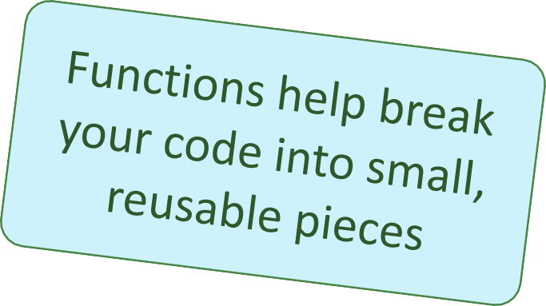
Components
Components are functions for user interfaces.
Input x
Output number
Math function:
let y = f(x);
Input x
Output HTML
Component function:
let y = <FancyDiv value={x} />;

Slide 14
Anatomy of a React Component
Inputs are passed through a single argument called “props”
The component is just a function.
The function outputs HTML
export default function MyComponent(props) {
return <div>Hello, world! My name is {props.name}</div>;
}
const html = <MyComponent name="aaron" />;
The function is executed as if it was an HTML tag
Parameters are passed in as HTML attributes

Slide 15
Component Rendering
When a component function executes, we say it “renders”.
Assume components may re-render at any time.
Our job is to ensure that
every time the component re-renders,
the correct output is produced.

Slide 16
“In React, everything is a component”
8 May 2024, Speaker name

Slide 17
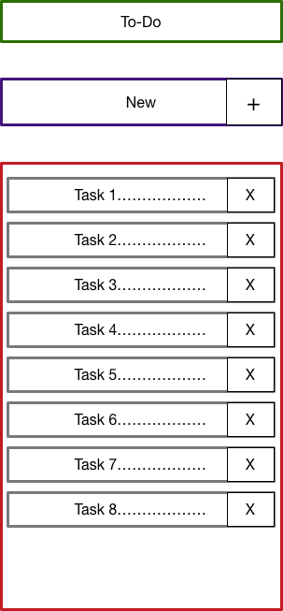
Todo Application
Title
Big idea:
TodoForm
A Digital To-do List
First step:
Mockup / Wireframe
TodoList
Todo

Slide 18
Creating a New React App
Creating a new React app is simple!
Install Node.js
Run: npx create-react-app app-name
New app created in folder: ./app-name

Slide 19
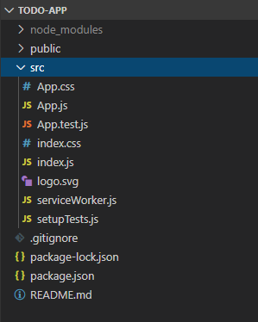
Anatomy of a New React App
public holds the initial html document and other static assets
App is a boilerplate starter component
index.js binds React to the DOM
package.json configures npm dependencies

Slide 20
Component Hierarchy
Title
TodoForm
App
Title
TodoList
TodoForm
TodoList
Todo
Todo
Todo
Todo

Slide 21
More on Hooks:
Custom Hooks
useMemo and useCallback
useReducer

Slide 22
Custom Hooks
import { useState } from 'react';
// Custom hook for boolean toggle state
function useToggle(initialValue = false) {
const [value, setValue] = useState(initialValue);
const toggle = () => {
setValue(!value);
};
return [value, toggle];
}
// Usage example
function ToggleComponent() {
const [isToggled, toggle] = useToggle(false);
return (
<div>
<button onClick={toggle}>
{isToggled ? 'ON' : 'OFF'}
</button>
<p>{isToggled ? 'The button is ON' : 'The button is OFF'}</p>
</div>
);
}

Slide 23
useMemo
useMemo: It memorizes the result of a function so that expensive calculations inside that function are only re-executed when its dependencies change. It is useful for optimizing performance by caching the result of expensive computations.
import React, { useMemo } from 'react';
const ExpensiveComponent = ({ data }) => {
const processedData = useMemo(() => {
// Perform expensive calculations
return data.map(item => item * 2);
}, [data]);
return (
<div>
{processedData.map((item, index) => (
<p key={index}>{item}</p>
))}
</div>
);
};
export default ExpensiveComponent;

Slide 24
useCallback
useCallback: It returns a memoized callback. It's useful when passing callbacks to optimized child components that rely on reference equality to prevent unnecessary renders.

Slide 25
useCallback
import React, { useState, useCallback } from 'react';
function ParentComponent() {
const [count, setCount] = useState(0);
const increment = useCallback(() => {
setCount((prevCount) => prevCount + 1);
}, []); // No dependencies, so it never changes
return (
<div>
<p>Count: {count}</p>
<ChildComponent increment={increment} />
</div>
);
}
function ChildComponent({ increment }) {
return <button onClick={increment}>Increment</button>;
}

Slide 26
useReducer
useReducer is a hook used for state management in React that is usually preferred for more complex state logic compared to useState. It is inspired by Redux and allows you to handle state transitions in a predictable way using a reducer function.

Slide 27
useReducer
import React, { useReducer } from 'react';
// Reducer function
const reducer = (state, action) => {
switch (action.type) {
case 'increment':
return { count: state.count + 1 };
case 'decrement':
return { count: state.count - 1 };
default:
throw new Error();
}
};
function Counter() {
const [state, dispatch] = useReducer(reducer, { count: 0 });
return (
<div>
<p>Count: {state.count}</p>
<button onClick={() => dispatch({ type: 'increment' })}>Increment</button>
<button onClick={() => dispatch({ type: 'decrement' })}>Decrement</button>
</div>
);
}

Slide 28

Knowledge Check

Slide 29
Question 1:What is the main advantage of using a component-based architecture in React?
A) It allows for direct manipulation of the DOM.
B) It improves performance by reducing DOM updates.
C) It requires less memory allocation compared to traditional JavaScript.
D) It simplifies server-side rendering.
Question 2:Which part of React is responsible for optimizing updates to the DOM?
Component-based architecture
B) Virtual DOM
C) Unidirectional data flow
D) JSX syntax
Question 3:Which tool is essential for setting up a React development environment?
A) Visual Studio CodeB) Node.js
C) Angular CLI
D) Java Development Kit (JDK)

Slide 30
Question 1:What is the main advantage of using a component-based architecture in React?
A) It allows for direct manipulation of the DOM.
B) It improves performance by reducing DOM updates.
C) It requires less memory allocation compared to traditional JavaScript.
D) It simplifies server-side rendering.
Question 2:Which part of React is responsible for optimizing updates to the DOM?
Component-based architecture
B) Virtual DOM
C) Unidirectional data flow
D) JSX syntax
Question 3:Which tool is essential for setting up a React development environment?
Visual Studio Code
B) Node.js
C) Angular CLI
D) Java Development Kit (JDK)

Slide 31
Question 4:Which lifecycle method in React is used to perform actions after the component has been rendered for the first time?
A) componentWillMount
B) componentWillUpdate
C) componentDidMount
D) componentDidUpdate
Answer: C) componentDidMount
Question 5:Which React hook is used to memoize the result of a complex computation to optimize performance?
A) useMemo
B) useCallback
C) useEffect
D) useReducerAnswer: A) useMemo

Slide 32
Question 4:Which lifecycle method in React is used to perform actions after the component has been rendered for the first time?
A) componentWillMount
B) componentWillUpdate
C) componentDidMount
D) componentDidUpdate
Question 5:Which React hook is used to memoize the result of a complex computation to optimize performance?
A) useMemo
B) useCallback
C) useEffect
D) useReducer

Slide 33
React Lab: Appointment Planner

Slide 34
React Lab: Jammming (Part 1)

Slide 35
React Lab: Jammming, Part 2

Slide 36
React Components Interacting Lab: CodeyOverflow Forum

Slide 37
React Jest Lab

Slide 38
React Hooks: Passing Thoughts

Slide 39
Saucy Tango Food Order

Slide 40
Playing Hooky

Slide 41
Web Apps Developer

